Slide 1
Evidence Based Funding at Pharm Companies
By Anne Song

Slide 2
Introduction
Transformation of Pharmaceutical Companies in past 15 years
Workflow automation throughout most big pharma companies
The funding budget for new instrument became one of big ticket item

Slide 3
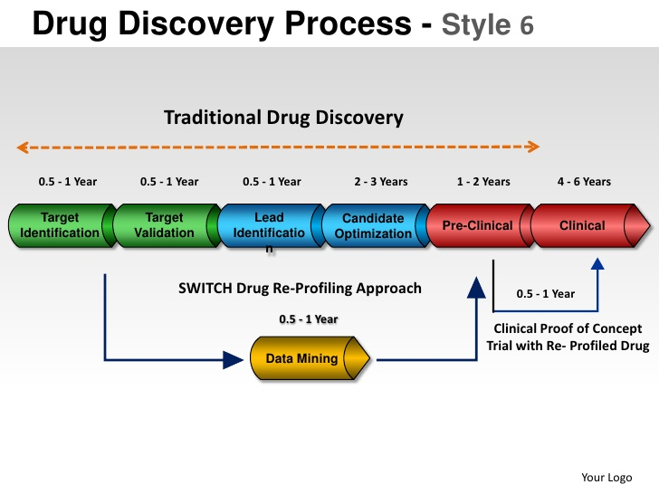
Brief Intro to Drug Development Process

Slide 4
Case Study : GeneData
It’s primary function is to analyze massive discovery phase data
*Assay Analyzer
Primary screening data (all single point data to get a feel for the success rate based on the chemical/physical properties
*Condoseo
Secondary screening to narrow down the potential targets (drug- able chemicals)
*Database Explorer
Combining above two sets of data, further analyze the leading targets
#To better determine the needs of the expensive licenses on each site, we compared two major sites’ (Basel and Nutley) usage log of Genedata.

Slide 5
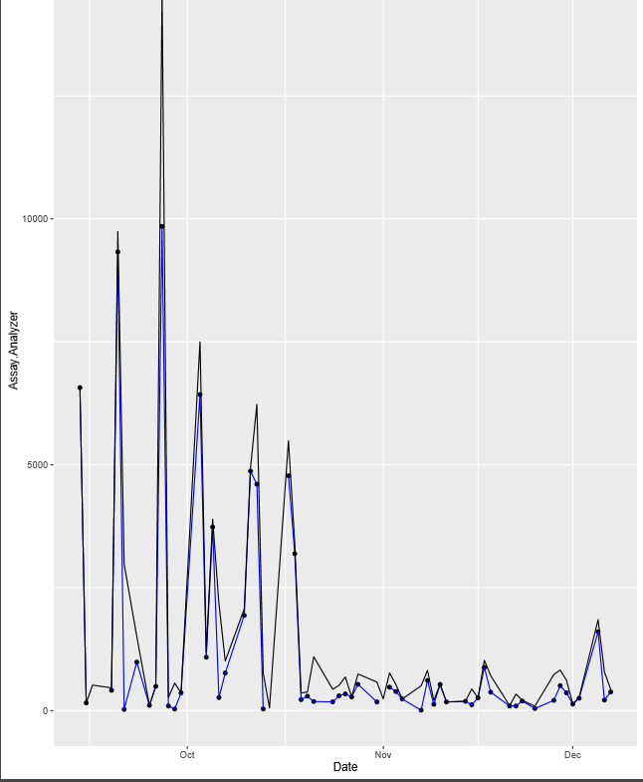
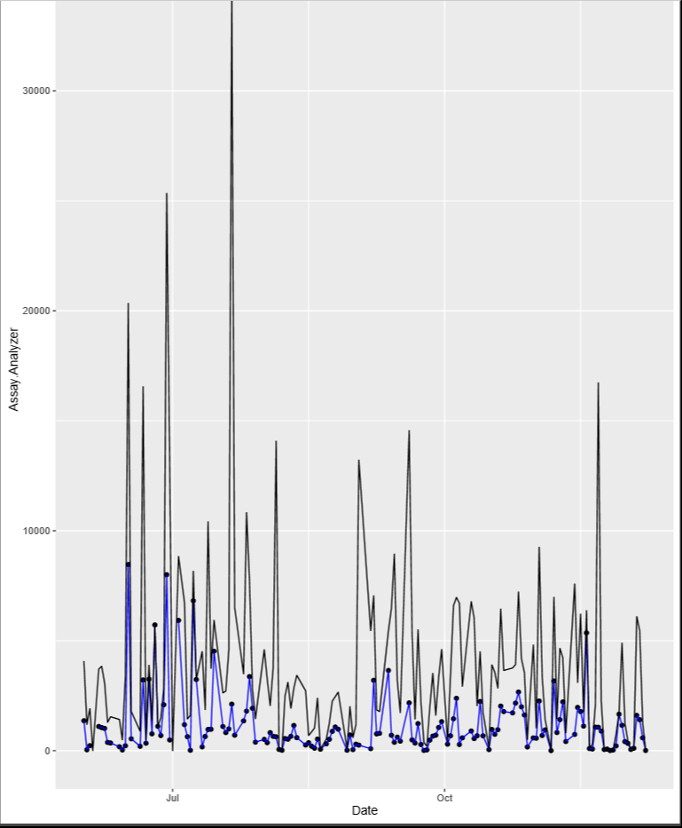
Plots of Basel and Nutley Usage Data Comparison (AssayAnalyzer)

Slide 6
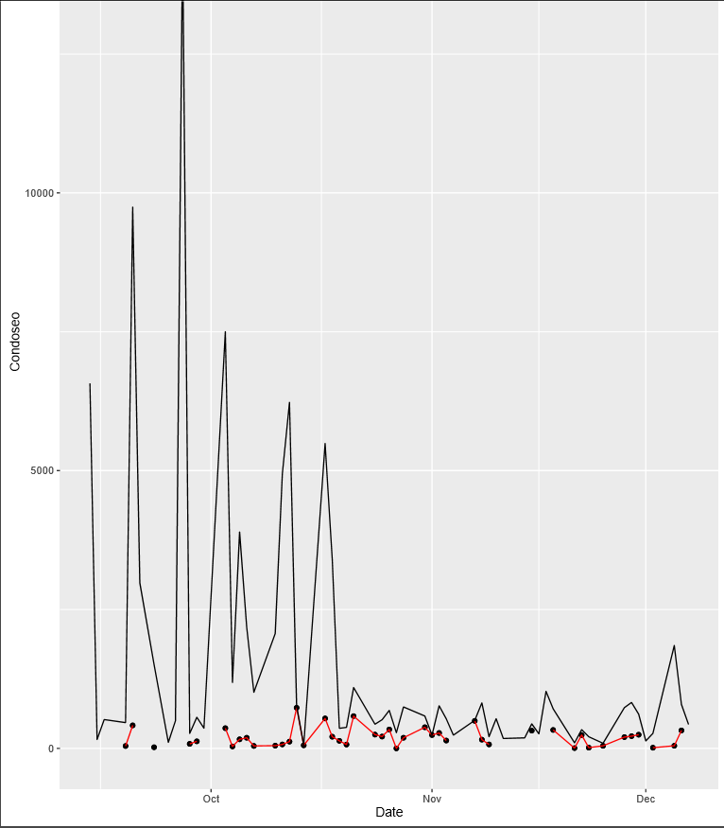
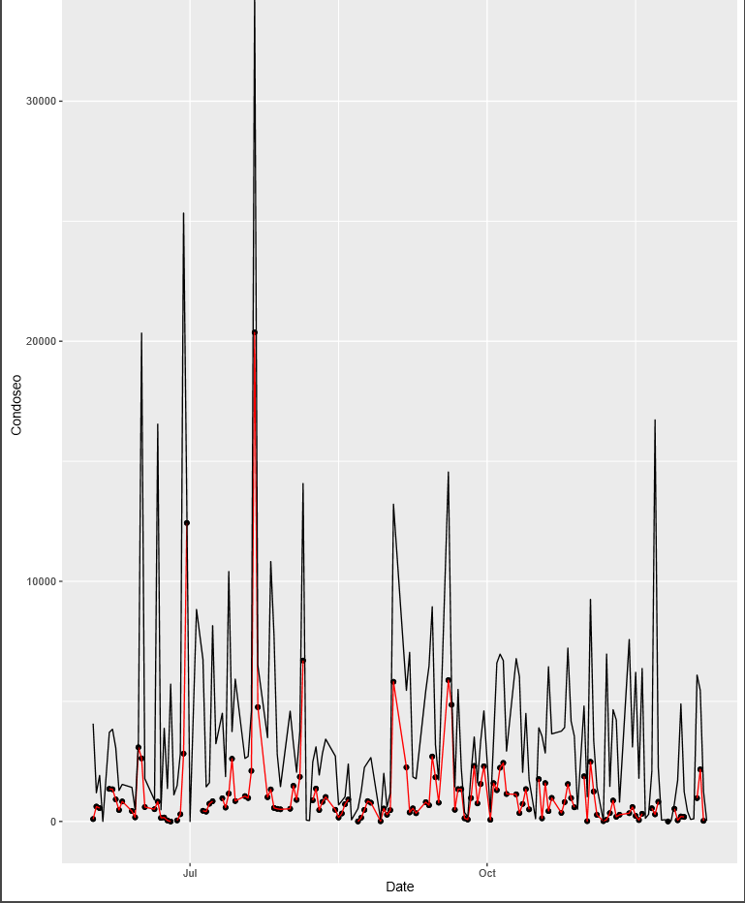
Basel Condoseo Usage Comparison Nutley

Slide 7
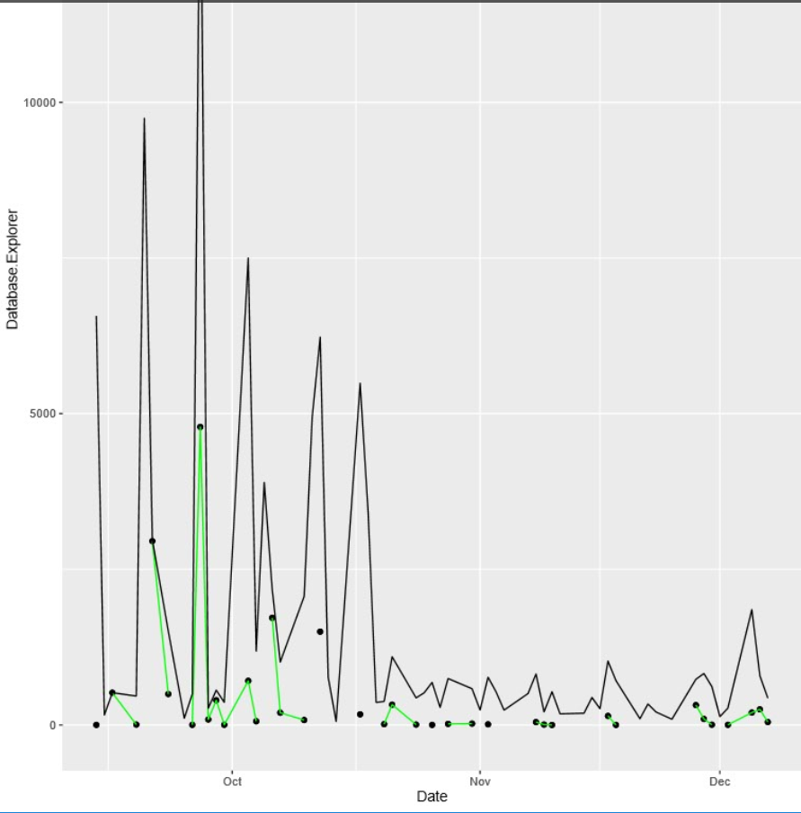
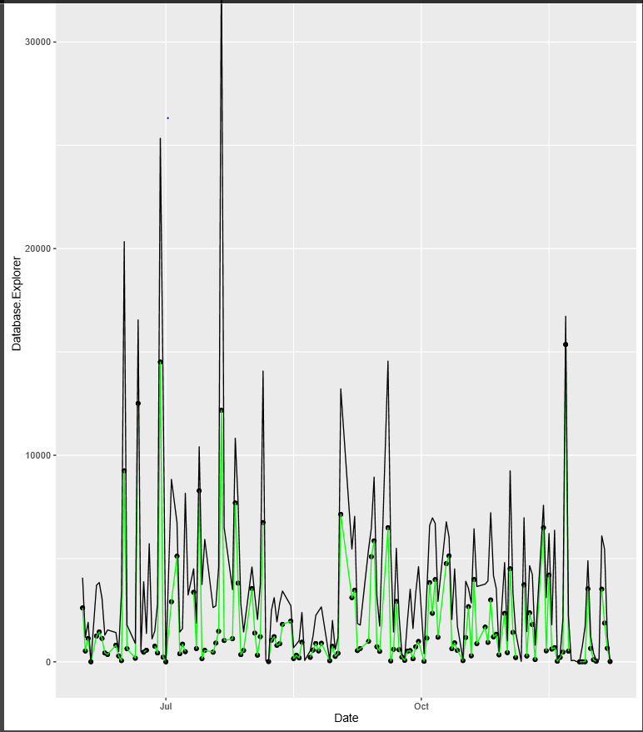
Basel Database Explorer Nutley

